Slide 1
Time Table Scheduling
Under the supervision of
Dr. Anuradha Dhull
Prepared by
Aashna Bansal 22csu006
Mehak Kaur 22csu117
Shefali Khera 22csu426
Shreya 22csu515

Slide 2
INDEX
INTRODUCTION | 3
2. ABOUT SYSTEM | 4
3. KEY FEATURES | 5
4. CODE STRUCTURES | 7
5. CODE | 8
6. OUTPUT | 11
7. CONCLUSION | 13

Slide 3
Introduction
The Timetable Scheduler, a Java-based program, has been meticulously developed to address the intricate task of scheduling and editing class timetables within an educational context. Grounded in fundamental principles of Data Structures and Algorithms (DSA), this software solution seeks to optimize the allocation of classes to various time slots and days, thereby enhancing the overall efficiency of timetable management. The intricacies inherent in this process are managed through a carefully designed user interface, providing a seamless experience for users to dynamically schedule and edit class timetables for a predefined set of subjects. The program accommodates a spectrum of constraints, including the classification of classes and the availability of time slots.

Slide 4
About System
Talking about the Timetable Scheduler in Java, this system is simple and very much user-friendly. Here the anchor of the system is the user. He can perform CRUD operations. Also, you can use this to generate weekly timetable and even edit it according to your preferences. With this project, you can easily manage your classes.
The design of this is so simple that the user won’t find difficulties while working on it. This project is easy to operate and understood by the users. To run this project you must have installed Eclipse IDE or Netbeans IDE or Visual Studio on your PC.

Slide 5
Key Features
1. Dynamic Scheduling Algorithm:
The core functionality of the scheduler revolves around a dynamic scheduling algorithm. It iterates through a set of subjects, evaluates constraints, and efficiently allocates classes to available time slots.
2. Error Handling Mechanisms:
Robust error handling mechanisms are integrated into the scheduler to manage diverse scenarios. This includes checks for invalid inputs, attempts to schedule labs or tutorials for subjects already assigned, and more.
3. Interactive Editing Capabilities:
Users can interactively edit the timetable by specifying the day and slot they intend to modify. The program intelligently checks the feasibility of the edit, ensuring that no edits occur in between lab or tutorial slots.

Slide 6
4. Constraints Management:
The scheduler enforces constraints such as preventing the scheduling of additional classes if a lab or tutorial is already assigned for the same subject on any given day. This enhances the integrity of the timetable.
5. User-Friendly Interface:
The program offers a user-friendly console interface, guiding users through the scheduling and editing processes. This ensures a seamless and intuitive user experience.
6. Code Organization:
The code follows a structured and modular approach, utilizing methods for different functionalities, enhancing readability and maintainability.
7. Scheduling Logic:
The scheduleClasses method efficiently allocates classes to available slots, considering constraints such as one class per subject per day and different slot requirements for lectures, labs, and tutorials.
8. Conflict Handling:
The program checks for existing labs or tutorials for a subject before scheduling a new one to avoid conflicts.

Slide 7
Code Structure
Scheduling Logic:
The central scheduling logic is encapsulated in the "scheduleClasses" function. It systematically processes subjects, adheres to constraints, and allocates classes to suitable time slots.
Error Handling:
The "isScheduled" function is dedicated to error handling, specifically checking for existing labs or tutorials scheduled for the same subject on any day. This serves to preempt scheduling conflicts
Interactive Editing:
The "editTimetable" function provides an interactive platform for timetable editing. It enforces constraints, preventing disruptions in lab or tutorial slots, and validates subject scheduling on the same day.
Utility Functions:
Utility functions like "getDay" and "getDayName" enhance code clarity by facilitating seamless conversion between day names and indices.

Slide 8
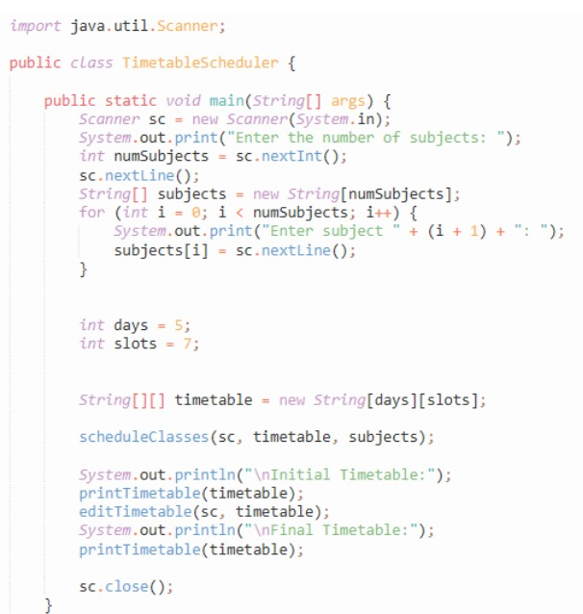
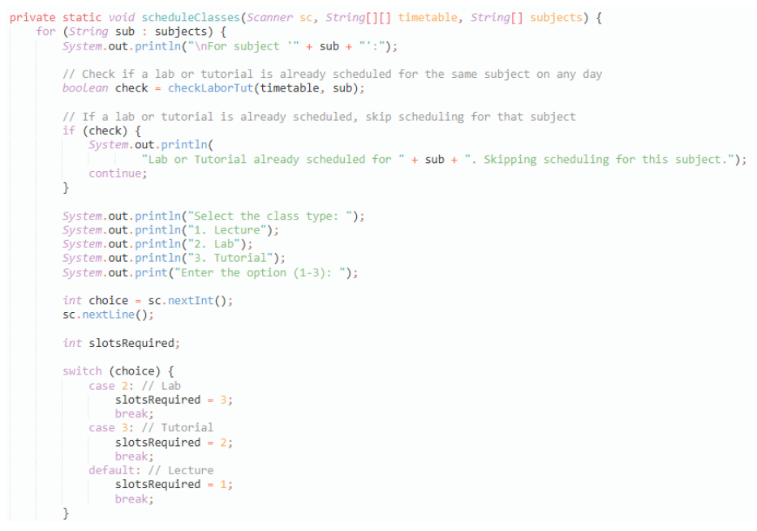
Code

Slide 9
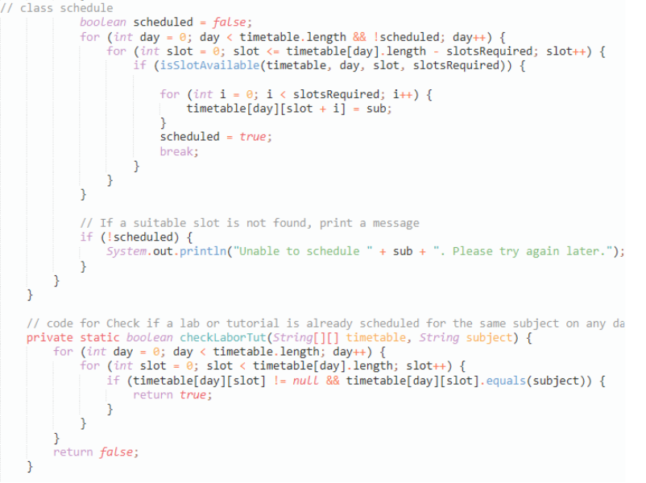
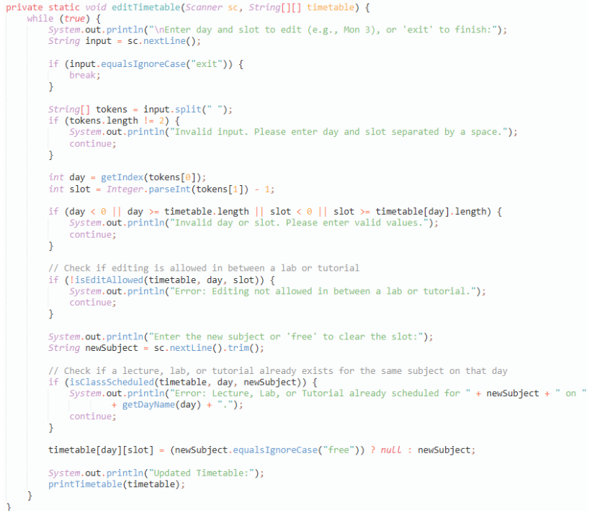

Slide 10
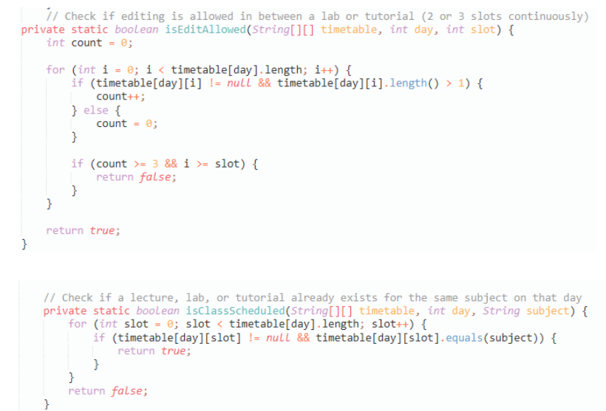
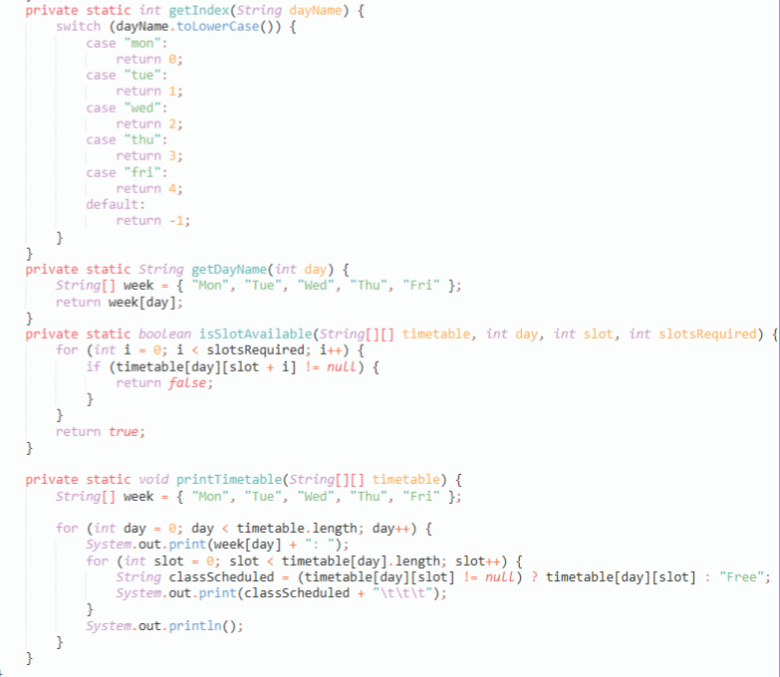

Slide 11
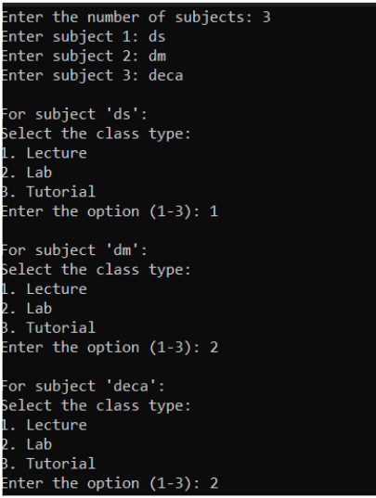
Output

Slide 12
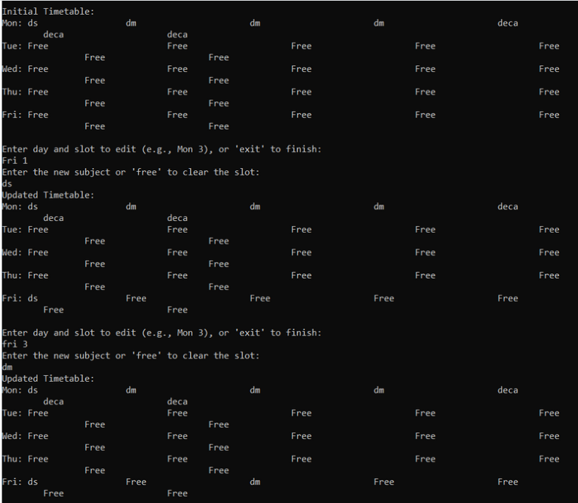

Slide 13
Conclusion
The Timetable Scheduler project serves as a pragmatic manifestation of Data Structures and Algorithms (DSA) principles within a real-world context. The program adeptly incorporates sophisticated scheduling algorithms, robust error handling mechanisms, and interfaces designed for user-friendly interactions. As a testament to its adherence to DSA tenets, the project underscores its capacity to address complex scheduling challenges efficiently.
This report furnishes a comprehensive overview delineating the salient features, structural intricacies, and operational functionalities of the Timetable Scheduler project. Emphasizing its fidelity to DSA principles, the report discerns areas conducive to future refinement. Prospective enhancements encompass the incorporation of additional scheduling constraints, the implementation of optimization techniques, and the integration of a Graphical User Interface (GUI) to augment overall usability.

